Slide 1
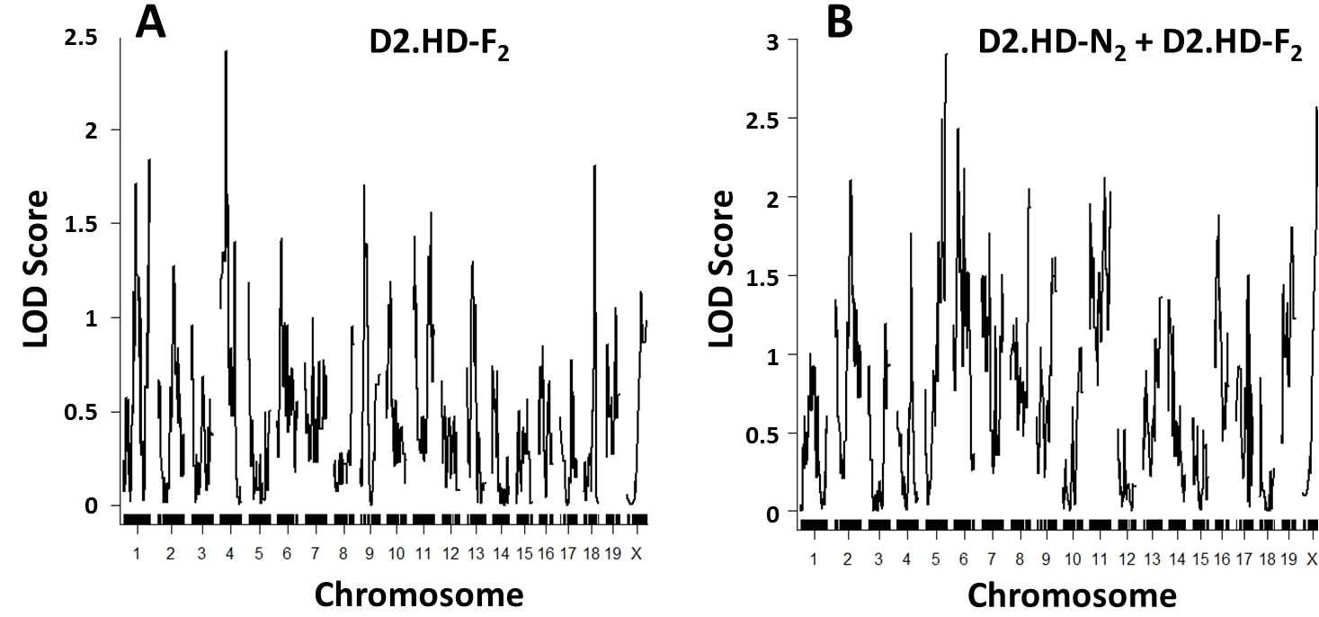
Additional file 2. QTL analysis results of D2.HD-F₂ and the combined D2.HD-N₂ and D2.HD-F₂ cohorts. D2.HD-F₂ (16 affected, 16 unaffected) and D2.HD-N₂ (19 affected, 6 unaffected) were combined and run as a single population (n=57) using an F₂ scenario in R/qtl. A. D2.HD-F₂ plot B. Combined plot. No significance was identified for F₂ or the combined populations.

